Slide 1
Who’s Asking?
Geoff Huston, Joao Damas
APNIC
Roy Arends
ICANN

Slide 2
Background
Experiments that are intended to expose the way in which recursive resolvers interact with the DNS root and its authoritative servers share a common weakness:
  It isn’t possible to trigger a particular response from root servers by varying the contents of the root zone, or by deliberating altering the behaviour of root servers in non-standard ways

Slide 3
Background
What we can do is create a comparable condition in a delegated zone at a lower point in the DNS name hierarchy to reproduce questions we’d like to ask of the root

Slide 4
Background
What we can do is create a comparable condition in a delegated zone at a lower point in the DNS name hierarchy to reproduce questions we’d like to ask of the root
What proportion of resolvers perform DNSSEC validation?
How many resolvers are capable of asking a query over TCP?
What proportion of resolvers are capable of querying using IPv6?
How do resolvers handle large DNS responses?

Slide 5
Background
But are these two environments the same?
Does the profile of query traffic seen an an authoritative name server match that seen at an authoritative name server?

Slide 6
Root Query Profiles
Let’s look at the profile of query traffic sent to a number root servers in the period January – March 2017

Slide 7
Root Query Profile
Queries of the Root Zone itself: 3.4%
Queries about delegated Zones: 30.3%
Queries about non-existent Zones: 66.3%
Most of the queries directed to root servers appear to relate to non-existant names (NXDOMAIN)
This does not include consideration of the validity of the 2ld (or deeper) in queries to delegated zones, so the “junk” ratio of queries seen at root servers is likely to be well in excess of 66%

Slide 8
Root Query Profile
TCP vs UDP:
UDP Queries: 98.3%
TCP Queries: 1.7%

Slide 9
Root Query Profile
TCP vs UDP:
UDP Queries: 98.3%
TCP Queries: 1.7%
There is an open question here whether this TCP query rate is a result of a prior query using no or a small EDNS(0) UDP Buffer size and receiving a truncated UDP response, or whether the resolver has chosen to use TCP without a prior UDP query and truncated response

Slide 10
Root Query Profile
DNS over IPv4 vs DNS over IPv6:
Queries over IPv4: 84.3%
Queries over IPv6: 15.7%

Slide 11
Root Query Profile
Query Types seen at a root server:

Slide 12
Root Query Profile
Query Types seen at a root server vs queries seen directed to a root server relating to the root zone itself:

Slide 13
Resolvers querying the Root
20M unique resolver IP addresses were seen in the analyzed data set

Slide 14
Top 20 Queriers
Resolver | Total Share of Queries | NXDOMAIN resp. rate |  | AS Name
199.16.156 | 0.22% | 6.9% |  | AS13414 - TWITTER - Twitter Inc., US, United States of America
212.19.128 | 0.21% | 0.5% |  | AS50482 - KAZAKHTELECOM-AS , KZ Kazakhstan
129.56.0 | 0.17% | 1.4% |  | AS327952 - AS-NATCOM, NG Nigeria
213.5.255 | 0.16% | 99.8% |  | AS50188 - KOLNET, PL Poland
213.5.255 | 0.16% | 99.9% |  | AS50188 - KOLNET, PL Poland
116.9.94 | 0.15% | 67.9% |  | AS4134 - CHINANET-BACKBONE No.31,Jin-rong Street, CN China
62.201.215 | 0.14% | 99.3% |  | AS44217 IQNETWORKS, IQ Iraq
129.56.0 | 0.11% | 1.7% |  | AS327952 - AS-NATCOM, NG Nigeria
104.156.86 | 0.11% | 0.0% |  | AS54113 - FASTLY, US United States of America
2a02:cb80:2110:: | 0.11% | 94.5% |  | AS43766 - MTC-KSA-AS , SA Saudi Arabia
85.62.233 | 0.11% | 100.0% |  | AS12479 - UNI2-AS , ES Spain
177.74.154 | 0.10% | 100.0% |  | AS263650 - Clicfacil Computadores, Servisos e Telecomunicate, BR Brazil
85.62.229 | 0.10% | 100.0% |  | AS12479 - UNI2-AS , ES Spain
199.59.148 | 0.09% | 6.6% |  | AS13414 - TWITTER - Twitter Inc., US, United States of America
61.164.15 | 0.09% | 0.0% |  | AS4134 - CHINANET-BACKBONE No.31,Jin-rong Street, CN China
204.194.239 | 0.09% | 94.2% |  | AS30607 302-DIRECT-MEDIA-ASN, US United States
2620:119:13:: | 0.09% | 94.3% |  | AS36692 - OPENDNS - OpenDNS, US United States of America
2620:119:13:: | 0.09% | 94.1% |  | AS36692 - OPENDNS - OpenDNS, US United States of America
2620:119:13:: | 0.09% | 94.0% |  | AS36692 - OPENDNS - OpenDNS, US United States of America
2620:119:13:: | 0.09% | 94.1% |  | AS36692 - OPENDNS - OpenDNS, US United States of America
As seen by one root server system over Feb 2017

Slide 15
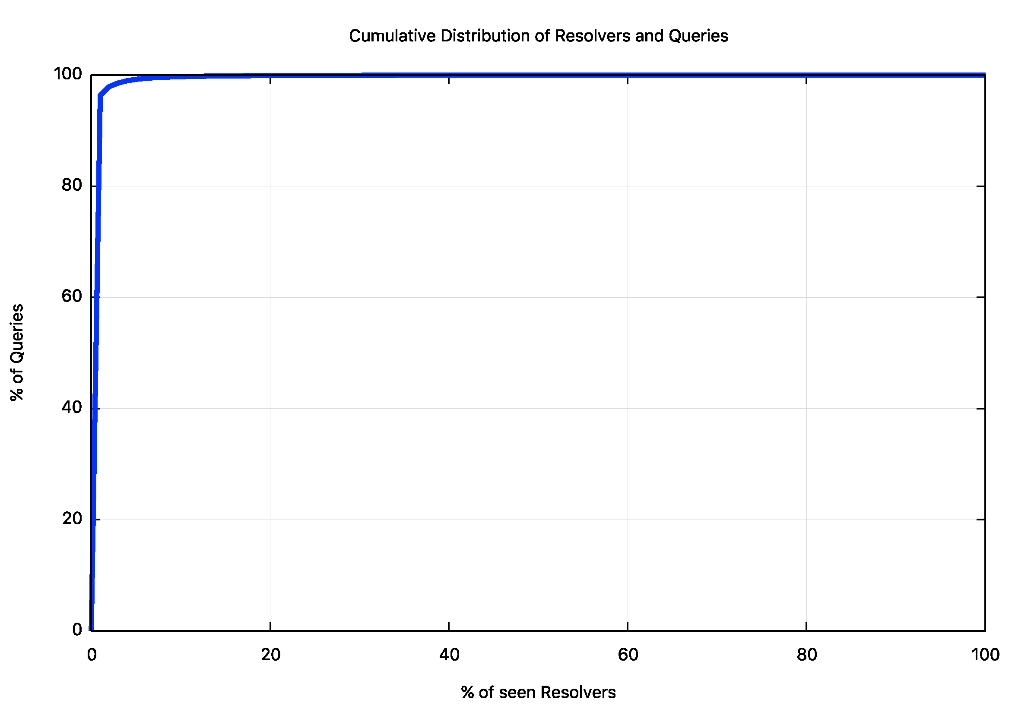
Query Intensity

Slide 16
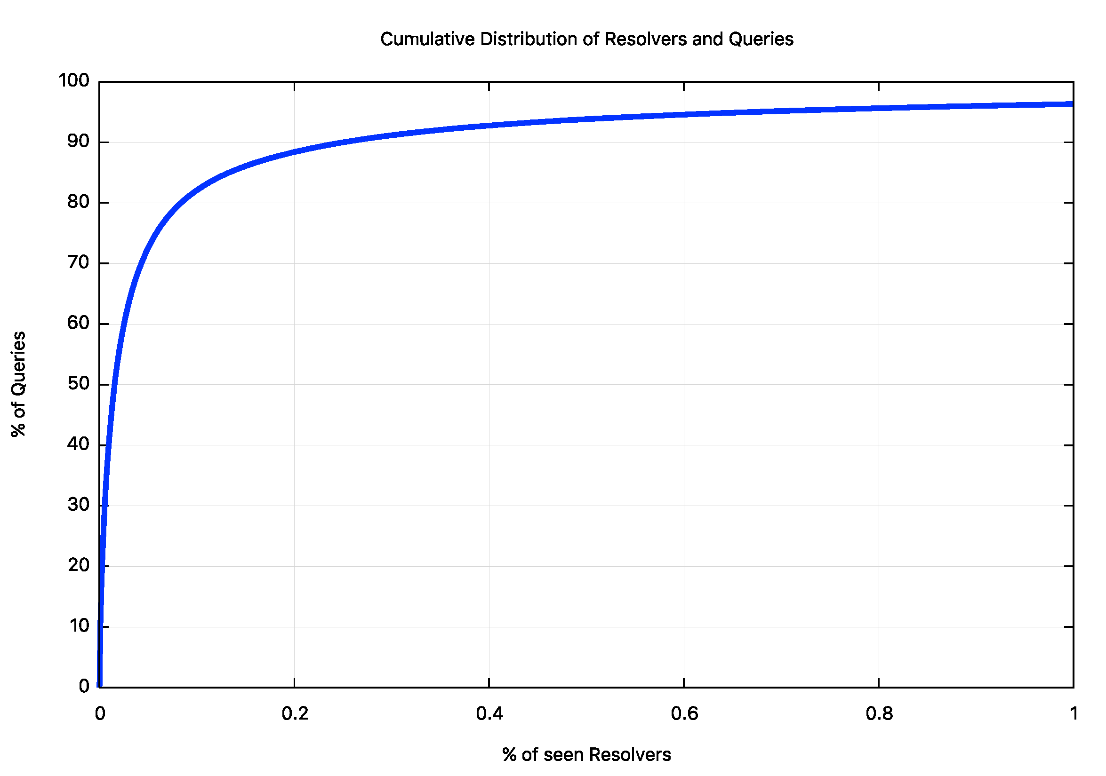
Query Intensity

Slide 17
Lets filter out NXDOMAIN queries…
Some 18M resolvers asked a query that related to either the root zone or a tld that is defined in the root zone (90% of the original resolver set)

Slide 18
Top 20 Queriers
Resolver | Total Share of Queries | Root vs TLD Query |  | AS Name
199.16.156 | 0.62% | 3.8% |  | AS13414 - TWITTER - Twitter Inc., US
212.19.128 | 0.61% | 0.1% |  | AS50482 - KAZAKHTELECOM-AS , KZ
129.56.0 | 0.51% | 0.3% |  | AS327952 - AS-NATCOM, NG
104.156.86 | 0.33% | 0.0% |  | AS54113 - FASTLY - Fastly, US
129.56.0 | 0.33% | 0.4% |  | AS327952 - AS-NATCOM, NG
61.164.15 | 0.26% | 0.0% |  | AS4134 - CHINANET-BACKBONE No.31,Jin-rong Street, CN
199.59.148 | 0.24% | 3.8% |  | AS13414 - TWITTER - Twitter Inc., US
207.179.70 | 0.22% | 0.4% |  | AS14103 - ACDNET-ASN1 - ACD.net, US
108.171.129 | 0.21% | 1.3% |  | AS25605 - SCANSAFE - SCANSAFE SERVICES LLC, US
209.143.22 | 0.19% | 1.0% |  | AS7106 - OHIOBRIGHTNET - Com Net, Inc., US
220.188.114 | 0.18% | 0.0% |  | AS4134 - CHINANET-BACKBONE No.31,Jin-rong Street, CN
180.137.252 | 0.16% | 0.0% |  | AS4134 - CHINANET-BACKBONE No.31,Jin-rong Street, CN
64.237.48 | 0.16% | 0.1% |  | AS20473 - AS-CHOOPA - Choopa, LLC, US
213.111.4 | 0.16% | 1.7% |  | AS39886 - NOMOTECH 53 avenue de la pierre vallee, FR
179.190.28 | 0.15% | 0.0% |  | AS52925 - ASCENTY DATA CENTERS LOCATIO E SERVICOS SA, BR
61.164.15 | 0.15% | 0.0% |  | AS4134 - CHINANET-BACKBONE No.31,Jin-rong Street, CN
116.9.94 | 0.15% | 7.7% |  | AS4134 - CHINANET-BACKBONE No.31,Jin-rong Street, CN
216.117.191 | 0.14% | 0.7% |  | AS10843 - AITNET - Advanced Internet Technologies, US
61.164.15 | 0.14% | 0.0% |  | AS4134 - CHINANET-BACKBONE No.31,Jin-rong Street, CN
85.93.93 | 0.14% | 1.9% |  | AS8972 - PLUSSERVER-AS , DE
As seen by one root server system over Feb 2017

Slide 19
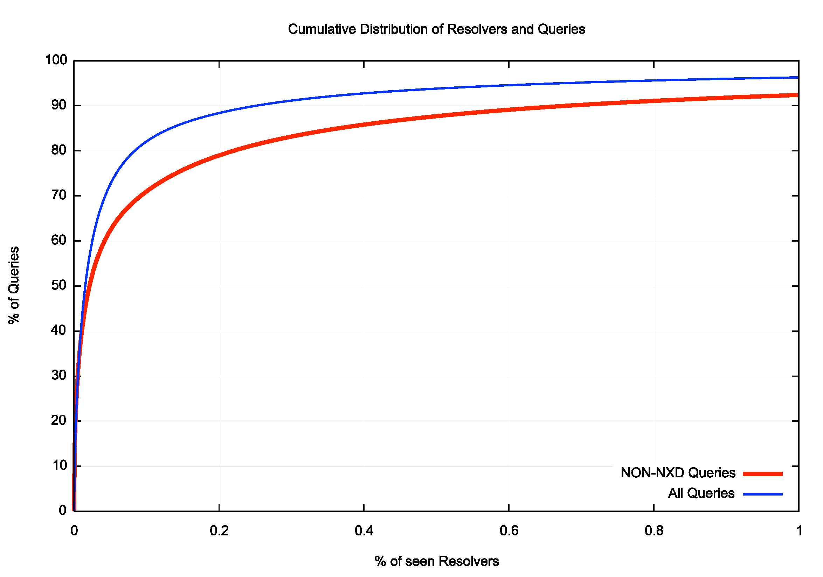
Query Intensity

Slide 20
Measuring the DNS
At APNIC the approach we’ve used for some years has been to use an online Ad campaign to test a particular DNS behavior across a large volume of end user browsers
The tests have included:
  DNSSEC validation
  large DNS responses
  TCP fall back
  Use of IPv6
  Mapping users to the resolvers that they use

Slide 21
Similarity
The question is how similar are the sets of resolvers that we see in queries generated by the Ads against what is seen by Root Servers?

Slide 22
Top 20 Queriers
As seen by APNIC DNS servers
Resolver | Share of Queries | AS Name
74.125.47.6 | 0.23% | AS15169 - GOOGLE - Google Inc.
74.125.47.13 | 0.23% | AS15169 - GOOGLE - Google Inc.
74.125.47.1 | 0.23% | AS15169 - GOOGLE - Google Inc.
74.125.47.7 | 0.23% | AS15169 - GOOGLE - Google Inc.
74.125.47.9 | 0.23% | AS15169 - GOOGLE - Google Inc.
74.125.47.3 | 0.23% | AS15169 - GOOGLE - Google Inc.
74.125.47.12 | 0.23% | AS15169 - GOOGLE - Google Inc.
74.125.47.2 | 0.23% | AS15169 - GOOGLE - Google Inc.
74.125.47.11 | 0.23% | AS15169 - GOOGLE - Google Inc.
74.125.47.8 | 0.23% | AS15169 - GOOGLE - Google Inc.
74.125.47.10 | 0.23% | AS15169 - GOOGLE - Google Inc.
74.125.47.5 | 0.23% | AS15169 - GOOGLE - Google Inc.
74.125.47.14 | 0.23% | AS15169 - GOOGLE - Google Inc.
74.125.47.4 | 0.23% | AS15169 - GOOGLE - Google Inc.
74.125.47.15 | 0.23% | AS15169 - GOOGLE - Google Inc.
74.125.181.6 | 0.22% | AS15169 - GOOGLE - Google Inc.
74.125.181.12 | 0.22% | AS15169 - GOOGLE - Google Inc.
74.125.181.8 | 0.22% | AS15169 - GOOGLE - Google Inc.
74.125.181.4 | 0.22% | AS15169 - GOOGLE - Google Inc.
74.125.181.7 | 0.22% | AS15169 - GOOGLE - Google Inc.

Slide 23
Similarity
The two data sets are obviously very different!
The APNIC data set is generated by presenting end users with unique domain names that are intended to negate any form of DNS caching
The root data set is (in theory) a set of cache miss queries
So its no surprise that these data sets are quite different

Slide 24
Similarity
So how can we compare the resolvers seen on these data collections?
One approach is to use the experiment’s script to direct the end user’s resolvers to query the root AND to query our experiment’s servers

Slide 25
Query Set
w.w.w.1du-u2f235731-c113-s1488343227-ib4040201-apnic-test
c.14u-u2f235731-c113-s1488343227-ib4040201.ape.dotnxdomain.net.
c.14s-u2f235731-c113-s1488343227-ib4040201.ape.dotnxdomain.net.
c.1du-u2f235731-c113-s1488343227-ib4040201.ape.dotnxdomain.net.

Slide 26
Experiment Query Set
w.w.w.1du-u2f235731-c113-s1488343227-ib4040201-apnic-test
c.14u-u2f235731-c113-s1488343227-ib4040201.ape.dotnxdomain.net.
c.14s-u2f235731-c113-s1488343227-ib4040201.ape.dotnxdomain.net.
c.1du-u2f235731-c113-s1488343227-ib4040201.ape.dotnxdomain.net.
Query directed to the root
Queries directed to the experiment’s server
These will resolve to a CNAME that redirects the resolver towards a non-existant domain name (that will be seen at a root server)

Slide 27
Query Behaviour
root server
.dotnxdomain.net
server
resolver
browser

Slide 28
Query Behaviour
root server
.dotnxdomain.net
server
cname response
resolver
browser

Slide 29
Query Behaviour
root server
.dotnxdomain.net
server
cname response
redirected query
resolver
browser

Slide 30
Query Behaviour
root server
.dotnxdomain.net
server
cname response
NXDOMAIN
response
redirected query
resolver
browser

Slide 31
Seen at the APNIC Server
04:40:28.029000 client 153.128.52.x#20314: q: c.14u-u2f235731-c113-s1488343227-ib4040201.ape.dotnxdomain.net. IN AAAA
04:40:28.028924 client 153.128.52.x#20822: q: c.14u-u2f235731-c113-s1488343227-ib4040201.ape.dotnxdomain.net. IN A
04:40:28.025044 client 153.128.52.x#20448: q: c.14s-u2f235731-c113-s1488343227-ib4040201.ape.dotnxdomain.net. IN A
04:40:28.045443 client 153.128.52.x#20069: q: c.1du-u2f235731-c113-s1488343227-ib4040201.ape.dotnxdomain.net. IN A
04:40:28.046542 client 153.128.52.x#20876: q: c.14s-u2f235731-c113-s1488343227-ib4040201.ape.dotnxdomain.net. IN AAAA
04:40:28.057989 client 153.128.52.x#21203: q: c.1du-u2f235731-c113-s1488343227-ib4040201.ape.dotnxdomain.net. IN AAAA
The end user appears to be a dual stack-connected device and these queries all generate CNAME responses that redirect the resolver to an undelegated name

Slide 32
Seen at a Root Server
04:40:27.980944 IP 153.128.52.x#20983: q: w.w.w.1du-u2f235731-c113-s1488343227-ib4040201-apnic-test. IN AAAA
04:40:27.983060 IP 153.128.52.x#20339: q: w.w.w.1du-u2f235731-c113-s1488343227-ib4040201-apnic-test. IN A
04:40:28.121397 IP 153.128.52.x#20104: q: w.w.w.14u-u2f235731-c113-s1488343227-ib4040201-cname-apnic-test. IN AAAA
04:40:28.146902 IP 153.128.52.x#20336: q: w.w.w.1du-u2f235731-c113-s1488343227-ib4040201-cname-apnic-test. IN A
04:40:28.440938 IP 153.128.52.x#20460: q: w.w.w.14s-u2f235731-c113-s1488343227-ib4040201-cname-apnic-test. IN A

Slide 33
Seen at a Root Server
04:40:27.980944 IP 153.128.52.x#20983: q: w.w.w.1du-u2f235731-c113-s1488343227-ib4040201-apnic-test. IN AAAA
04:40:27.983060 IP 153.128.52.x#20339: q: w.w.w.1du-u2f235731-c113-s1488343227-ib4040201-apnic-test. IN A
04:40:28.121397 IP 153.128.52.x#20104: q: w.w.w.14u-u2f235731-c113-s1488343227-ib4040201-cname-apnic-test. IN AAAA
04:40:28.146902 IP 153.128.52.x#20336: q: w.w.w.1du-u2f235731-c113-s1488343227-ib4040201-cname-apnic-test. IN A
04:40:28.440938 IP 153.128.52.x#20460: q: w.w.w.14s-u2f235731-c113-s1488343227-ib4040201-cname-apnic-test. IN A
These queries were originally directed to a root
CNAME-generated responses that direct the resolver to a root. *
* Why are the cname generated queries only for A OR AAAA and not both?

Slide 34
Query Ratio
Each experiment generates approximately the same number of queries towards a root server as to the experiment’s server (5:6)
But we are using the logs from a single root server here
If resolvers evenly distribute queries across all root server letters over time then we could expect to see a query ratio of 0.08 in the data

Slide 35
Query Ratio
Average query ratio: 0.06
This slightly less than the anticipated number
A possible reason is that the larger resolvers are performing some form of local root zone caching

Slide 36
Query Ratio
If
  the resolver is performing NSEC caching, or
  the resolver is working with a local copy of the root zone (RFC7706), or
  The resolver has latched onto a different root server letter,
Then we should see a far lower query ratio for that resolver

Slide 37
Google PDNS Query Ratio
Google DNS query ratio: 0.0008
  This is around 1/100 of the calculated ratio
  It is a likely side effect of some form of NSEC caching being performed by Google’s resolvers

Slide 38
Comcast Resolver Query Rate
Comcast DNS query ratio: 0.004
  This is 1/20 of the expected query rate – either Comcast’s resolvers are performing some form of local root zone caching or their resolvers have latched onto a different Root Zone server letter

Slide 39
Correlation
In a one month period (Feb 17) 10,000 resolvers made 90% of the queries to the experiment servers (out of a total of 375,206 resolver IP addresses)
Of these 10,000 resolvers:
  8,600 were seen by this root server letter cluster
  1,400 were not seen at all by this root server letter (of these 1,116 were IPv6 addresses, indicating a possible IPv6 reachability issue with this root server)

Slide 40
Correlation
These 8,600 resolvers:
  Made 75% of the queries seen at the experiment servers
  Made 87% of the experiment-related queries seen at this root
  Appear to carry the bulk of the browser level DNS resolution traffic for the Internet

Slide 41
Preliminary Findings
Most of the resolvers seen at the root appear to make a very small number of queries
  99% of the seen resolvers asking queries of the root are responsible for less than 4% of the total query count
  10% of the seen resolvers ask only for non-existent domain names
  This is a very long tail distribution set

Slide 42
Preliminary Findings
Resolvers who are seen to query at lower levels of the DNS are also likely to be seen by the root servers
  Although the intensity of queries may differ due to various forms of local root zone content caching
The opposite is not necessarily the case, in that resolvers seen to ask queries of the root may not necessarily be observed asking queries of servers at lower levels of the DNS (10% of the seen resolvers were not observed to ask a query about a delegated name)

Slide 43
Preliminary Findings
Resolvers appear to be less likely to exclusively latch onto a single root letter, and appear to distribute their queries to all root server letters over time

Slide 44
Preliminary Findings
Some resolvers (and some large scale resolvers) are using either NSEC caching or some form of RFC7706-style of local root zone caching
This has dramatically reduced their query rate to root servers for non-existent domain names

Slide 45
Preliminary Findings
IPv6 still presents some reachability issues for some roots and some resolvers

Slide 46
This is work in progress
Further questions in this study:
Can we map users to the resolvers to root server letter preference (if any)?
Can we cast any light on resolver “latching” to a root service letter?
How widespread are the IPv6 connectivity issues?
Can we track the uptake of aggressive NSEC caching of the root zone in resolvers?

Slide 47
Questions?

